Slide 1
Module 20

Slide 2
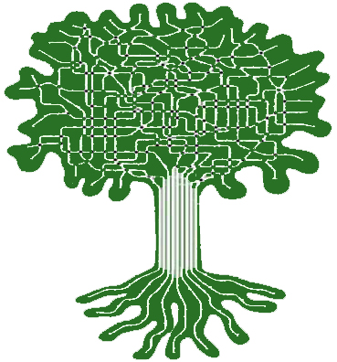
PLANT’S
TRANSPORT
SYSTEM

Slide 3

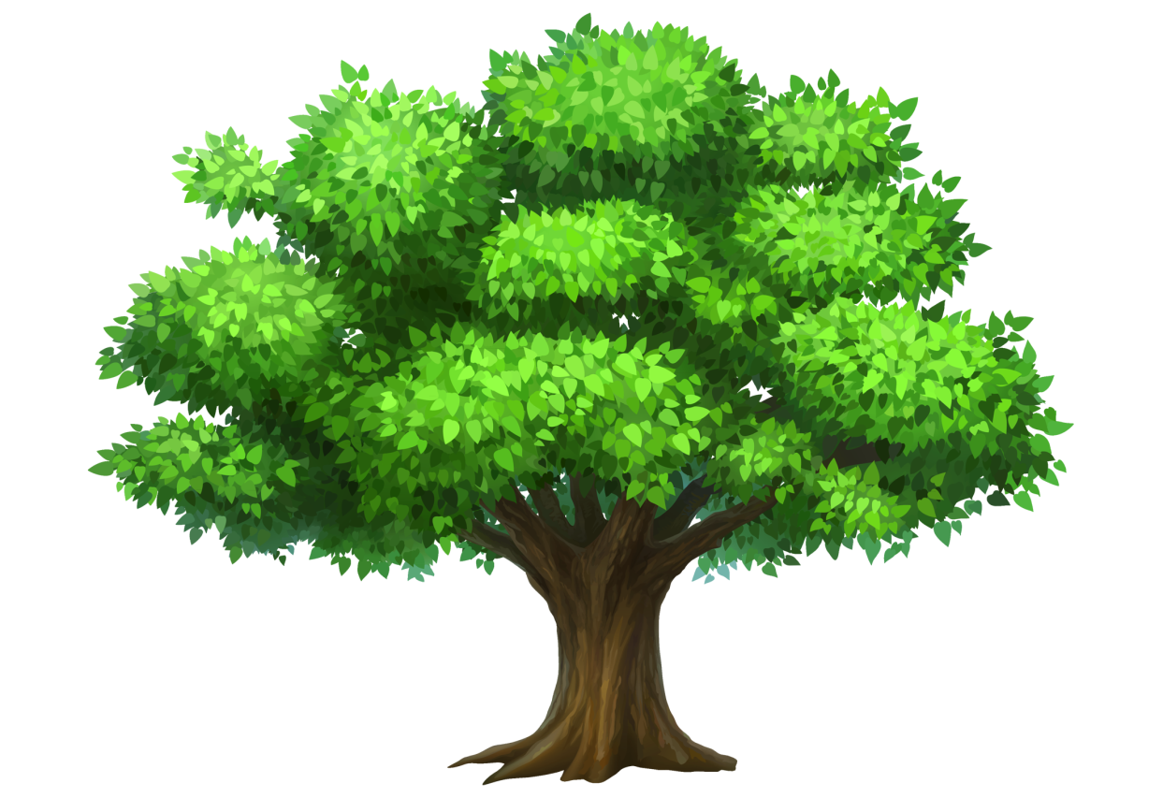



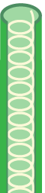
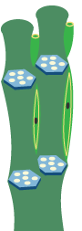
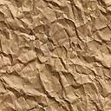
Inorganic materials
Which include
Nitrogen,
Phosphorus,
Magnesium,
Manganese,
Sodium
In xylem tissues cells like vessels and tracheids of the roots, stems and leaves are interconnected to form a continuous system of water-conducting channels reaching all parts of the plants.
All the parts of the plant are interconnected with these conducting tissues.
G
G
G
Xylem
Phloem
Carries food to other parts
Carries water and minerals
Soil
Water
Minerals

Slide 4
Transport of water in plants
Takes place by two ways
Root pressure
Transpiration pull
Now first let us see root pressure

Slide 5




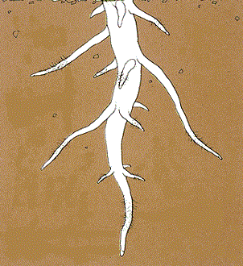
Water molecules enter from the roots
Due to difference in concentration
Water
Soil
Water

Slide 6

Xylem
Through the root hair, water first enters the surface cells.
This pressure is called as root pressure.
Thus the minerals and water reach the xylem and it pushed further and further.
The surface cells become turgid and exert pressure on the neighbouring cortex cells.
Now the neighbouring cells become turgid and exert pressure on adjacent cells.
This steady movement creates a column of water that is steadily pushed upwards.
Because of this water and minerals are pushed into neighbouring cells.
Cortex cells
Surface cells
Root hair
Water & Minerals

Slide 7
Thank You

